Slide 1
More Than Migrants: An Introduction to Hispanic Heritage Month
How are we called to see our Hispanic siblings in Christ as beloved children of God?

Slide 2
Biblical Foundation
Christ calls upon us to love our neighbors as ourselves (Luke 10:27). Christ does not qualify this mandate.
“What does the Lord require of you but to do justice, and to love kindness and to walk humbly with your God?” Micah 6:8
“Let us not grow weary in doing good.” Galatians 6:9
“Learn to do good; seek justice, rescue the oppressed, defend the orphan, plead for the widow.” Isaiah 1:17
"But now, this is what the Lord says--he who created you, Jacob, he who formed you, Israel: 'Do not fear, for I have redeemed you; I have summoned you by name; you are mine!" Isaiah 43:1
Notes:
The overarching theme in the Bible of welcoming the outcast and advocating for the oppressed:
Throughout the Old Testament, God works with the Israelites, a small tribe of people constantly set against and warring with other tribes and nations around them. The books of Leviticus and Deuteronomy record rules about leaving behind wheat and other foods in fields, so that the poor and homeless could collect them for food. (Leviticus 19:9-10; Deuteronomy 24:19). The prophet Ezekiel condemns the cities of Sodom and Gomorrah for their greed and lack of care for the needy (Ezekiel 16:49-50). In the New Testament, Jesus reaches out to many people on the margins, including tax collectors (Matthew 9:10-13, Luke 19:1-10), demon possessed (Matthew 8:28-34, Mark 1:21-28), women (Luke 8-3), John 4:1-42), and children (Matthew 19:13-15). Following in his footsteps, the early church welcomes Gentile believers (Acts 8:26-40, Acts 10:1-48, Romans 2:9-11, Galatians 2:15-21), even though Gentiles were excluded from the Jewish faith in which the disciples and Jesus had been raised. From these examples and many more, many faithful Christians believe that the Bible contains a theme of advocating for those on the margins of society, and welcoming them into God’s family despite the fear of many. Many of these Christians believe the same kind of welcome is extended by God to LGBTQIA+ people.
Acts 8:26-40 (Philip and the Ethiopian)
²⁶ Now an angel of the Lord said to Philip, “Go south to the road—the desert road—that goes down from Jerusalem to Gaza.” ²⁷ So he started out, and on his way he met an Ethiopian^{[a]} eunuch, an important official in charge of all the treasury of the Kandake (which means “queen of the Ethiopians”). This man had gone to Jerusalem to worship, ²⁸ and on his way home was sitting in his chariot reading the Book of Isaiah the prophet. ²⁹ The Spirit told Philip, “Go to that chariot and stay near it.”
³⁰ Then Philip ran up to the chariot and heard the man reading Isaiah the prophet. “Do you understand what you are reading?” Philip asked.
³¹ “How can I,” he said, “unless someone explains it to me?” So he invited Philip to come up and sit with him.
³² This is the passage of Scripture the eunuch was reading:
“He was led like a sheep to the slaughter, and as a lamb before its shearer is silent, so he did not open his mouth. ³³ In his humiliation he was deprived of justice. Who can speak of his descendants? For his life was taken from the earth.”^{[b]}
³⁴ The eunuch asked Philip, “Tell me, please, who is the prophet talking about, himself or someone else?” ³⁵ Then Philip began with that very passage of Scripture and told him the good news about Jesus.
³⁶ As they traveled along the road, they came to some water and the eunuch said, “Look, here is water. What can stand in the way of my being baptized?” ^{[37] [c]} ³⁸ And he gave orders to stop the chariot. Then both Philip and the eunuch went down into the water and Philip baptized him. ³⁹ When they came up out of the water, the Spirit of the Lord suddenly took Philip away, and the eunuch did not see him again, but went on his way rejoicing. ⁴⁰ Philip, however, appeared at Azotus and traveled about, preaching the gospel in all the towns until he reached Caesarea.

Slide 3
No
Experts
Acknowledge that there are no experts in the room – we’re all here to learn, including the facilitators!
Assume
+ Intent
Assume positive intent and offer grace readily.
Pay
Attention
Respect the confidentiality of our conversations.
Brave
Space
Pay attention to how these discussions make us feel. It’s okay to be uncomfortable.
Confidentiality
Honor our time together as a “brave space” with room for multiple perspectives, knowing that we are all at different places on this journey.

Slide 4
Self- Assessment: A Guide for Understanding
True or False: Puerto Ricans are immigrants to the United States.
True or False: Every country in Latin America and South America speak Spanish.
True or False: By 2050, the United States will have 138 million people who speak Spanish.
True or False: Spanish is the second fastest growing language in the United States.
True or False: Most foreign-born Hispanic immigrants are unauthorized migrants.
True or False: Latin American / Hispanic culture has had little impact in American culture.

Slide 5
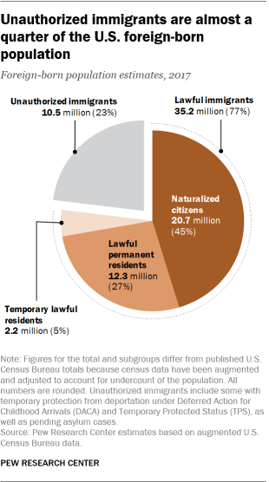
Self- Assessment: Answer Key
True or False: Puerto Ricans are not immigrants, just like a Floridian is not an immigrant if they move to another state. They are U.S. citizens by birth.
True or False: Every country in Latin America and South America speak Spanish. Brazil (Portuguese), Guyana (English), French Guiana (French), Suriname (Dutch) Haiti (French) don’t speak Spanish. In addition, there are 56 language families and hundreds of other related dialect / languages spoken in Latin America.
True or False: By 2050 in the United States there will be around 138 million people who speak Spanish. This will equate to more than any other country based on population size.
True or False: Spanish is the second fastest growing language in the United States. It has grown by 233% since 1980 which is second to Vietnamese which grew 599% in the same amount of time.
True or False: Most foreign-born Hispanic immigrants are unauthorized migrants. About 77% or 35.2 million are naturalized citizens and only 23% or 10.5 million are unauthorized immigrants.
True or False: Hispanics are the most culturally influential minority and ethnic group in the United States.

Slide 6
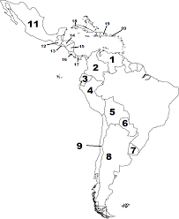
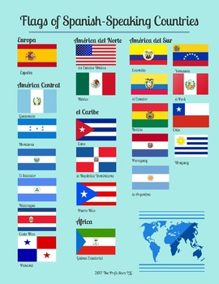

Slide 7
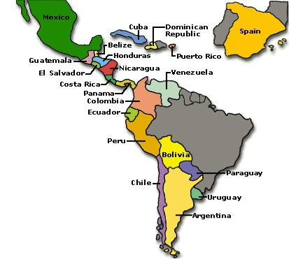

Slide 8
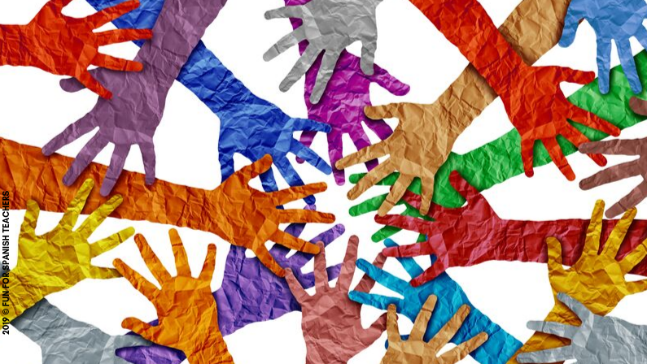
Discuss with your table:
What were facts that shocked you? Surprised you? Sparked excitement or interest?
How does this new knowledge affect the way you see the Hispanic community in Minnesota?
How has the Hispanic history you have heard been influenced by the immigrant story? How do these stories affect how we view God?

Slide 9
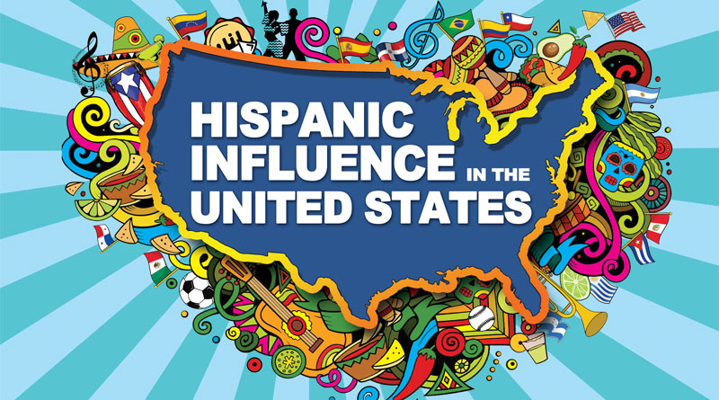

Slide 10
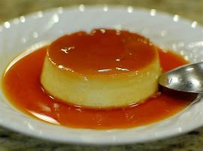
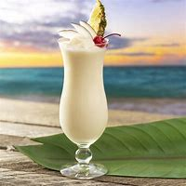
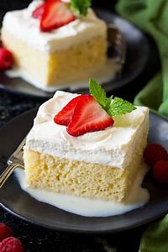
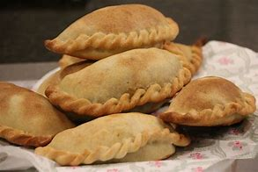
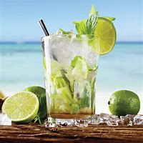
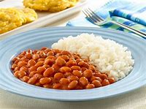
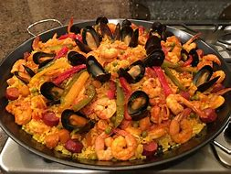
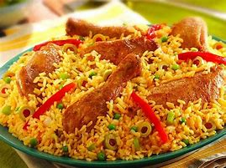
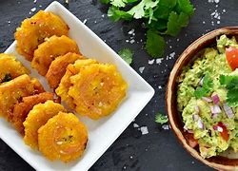
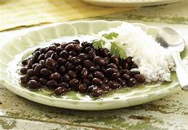
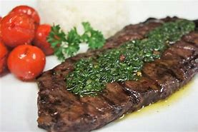
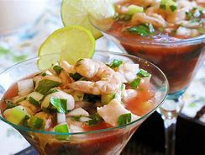
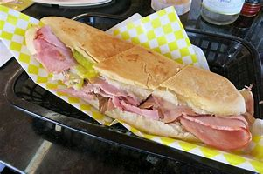
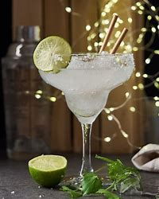

Slide 11
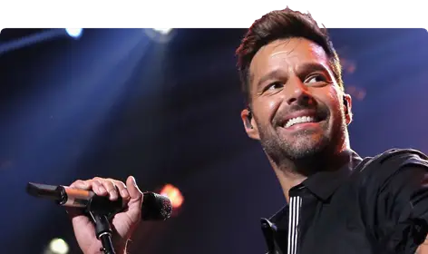
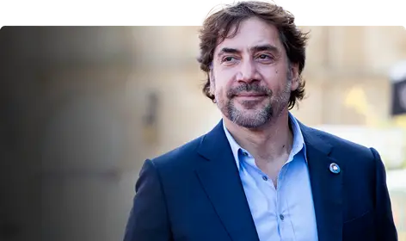
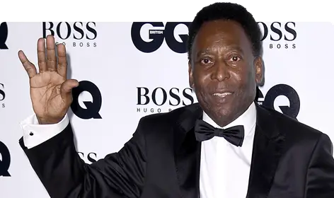
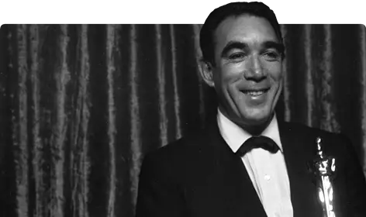
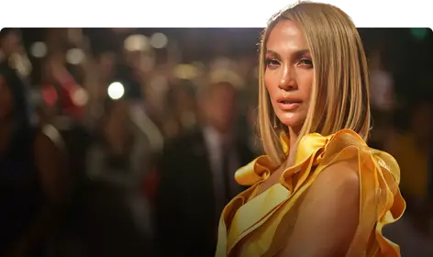
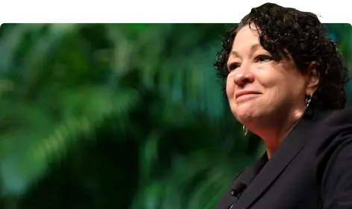
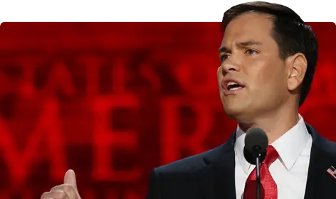
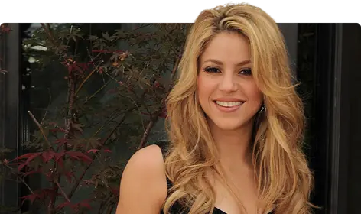
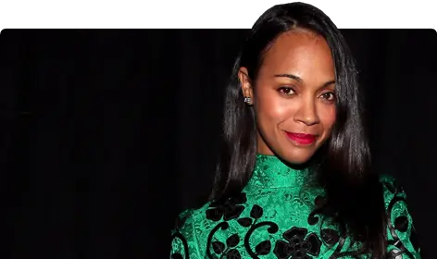
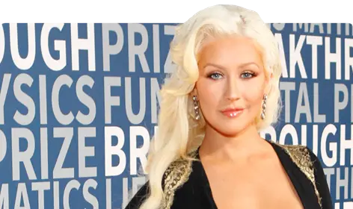
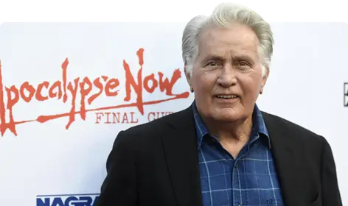
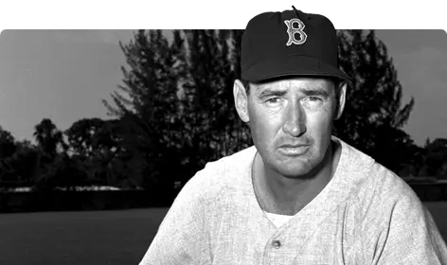
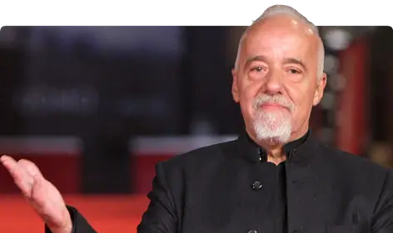
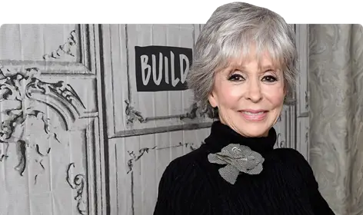
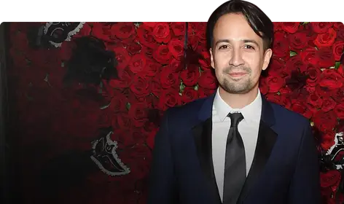

Slide 12
Hispanic Culture Impact on American Culture
Language – Spanish is the second most spoken language in the United States.
There are over 60 million Hispanics/Latin Americans living in the United States
Food – From tacos & margaritas (Mexico), churrascos (Argentinian style steaks), empanadas (Argentina, Spain, Chile), Paella (Spain), Ceviche (Peru, Ecuador, Mexico), Mojito (Cuba), Tres Leches (Mexico, Nicaragua, Panama, Cuba, Puerto Rico, Guatemala, Costa Rica) to rice and beans (most of Latin America). The influence and rise of Latin cuisine in the United States is evident and very popular from fast food to gourmet cuisine.
The following is a short list of cultural influencers either born in Latin America/Spain or have Hispanic heritage:
Sports – Baseball, boxing, soccer, tennis – many great “All Stars” are from Hispanic heritage. Sammy Sosa & Alex Rodriguez (Dominican Republic), Roberto Clemente (Puerto Rico), Lionel Messi (Argentina), Rafael Nadal (Spain), Pele (Brazil), Julio Cesar Chavez (Mexico), Ted Williams (Spain/Mexico), Carmelo Anthony (Puerto Rico)
Pop Culture / Music – Salsa, merengue, reggaeton, and classic oldies like mambo & rumba – all come from Latin/Hispanic roots. Lin-Manuel Miranda, Tito Puente, Jennifer Lopez, Ricky Martin & Marc Anthony (Puerto Rico), Pitbull, Gloria Estefan & Camila Cabello (Cuba), Shakira & Maluma (Colombia), Christina Aguilera (Ecuador), Carlos Santana & Ritchie Valens (Mexico)
Pop Culture / Film – Salma Hayek & Anthony Quinn (Mexico), Zoe Saldana (Dominican Republic), Penelope Cruz & Javier Bardem (Spain), Benicio del Toro, Jimmy Smits & Rita Moreno (Puerto Rico) (Rita was the first Hispanic woman to win an Oscar and one of 16 EGOT!), Andy Garcia (Cuba), Ramon Estevez AKA Martin Sheen (Spain)

Slide 13
Hispanic Culture Impact on American Culture
Politics – Jorge Ramos (Mexican political journalist), Justice Sonia Sotomayor (Puerto Rican – first Hispanic appointed to the U.S. Supreme Court), Ted Cruz and Marco Rubio (Cuban), Alexandria Ocasio-Cortez (Puerto Rican)
Literature – Gabriel Garcia Marquez (Nobel Prize in Literature, 100 Years of Solitude – Colombia), Paulo Coelho (The Alchemist – Brazil), Gabriela Mistral (Poet and first Latin American author to receive a Nobel Prize in Literature – Chile), Isabel Allende (The House of the Spirits - Peru), Miguel de Cervantes (Don Quixote - Spain)
Entrepreneurs – Alberto Perez (Zumba - Colombia), Marcelo Claure (Brightstar and Sprint - Bolivia)
Fashion Designers/Haute Couture – Manolo Blahnik (Spain), Oscar de la Renta (Dominican Republic), Carolina Herrera (Venezuela), Cristobal Balenciaga (Spain)

Slide 14
Think of your day-to-day experience, how has the Hispanic culture influenced things you experience and enjoy? How will this shape how we view our connection to the Hispanic community?

Slide 15
Heritage and Identity
"You are not lucky to be here. The world needs your perspective.
They are lucky to have you.“
- Antonio Tijerino, President & CEO of the Hispanic Heritage Foundation

Slide 16
Defining Latino: Young People Talk Identity, Belonging | NBC Latino | NBC News - Bing video

Slide 17
Identities Matter
Language: Latinx vs Hispanic:
Latino, Latina, Latinx: people who come from Latin American countries and cultures (Central, South, and Caribbean), self-identified
Hispanic: people who come from Spain and/or countries that were settled by the Spaniards; cultural and historical link to Spain, self-identified
Preference depends on personal choice and their own background
Cultural Representation:
Raise your hand if you are: Swedish, Norwegian, or German? Now think about if you were all identified as Swedish…how do you feel?
“My greatest strength is knowing who I am and where I come from, my island.” Oscar de la Renta

Slide 18
Ethnicity versus Race
It's common to see the terms "race" and "ethnicity" used interchangeably, but, generally speaking, the meanings are distinct.
Race is usually seen as biological, referring to the physical characteristics of a person, while ethnicity is viewed as a social science construct that describes a person's cultural identity.
Ethnicity can be displayed or hidden, depending on individual preferences, while racial identities are always on display, to a greater or lesser degree.

Slide 19
A Conversation With Latinos on Race | Op-Docs - Bing video

Slide 20
Think about your name. What memories does it bring? How does it feel when people use it correctly?
Notes:
Talk about tips and tricks to pronouncing a name correctly and the power of your name

Slide 21
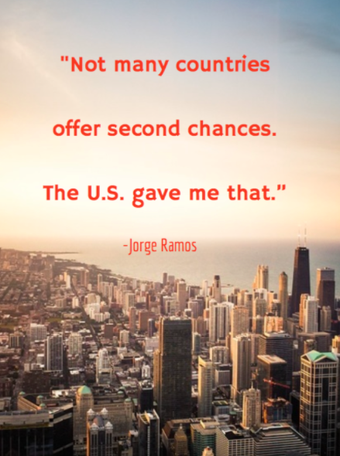
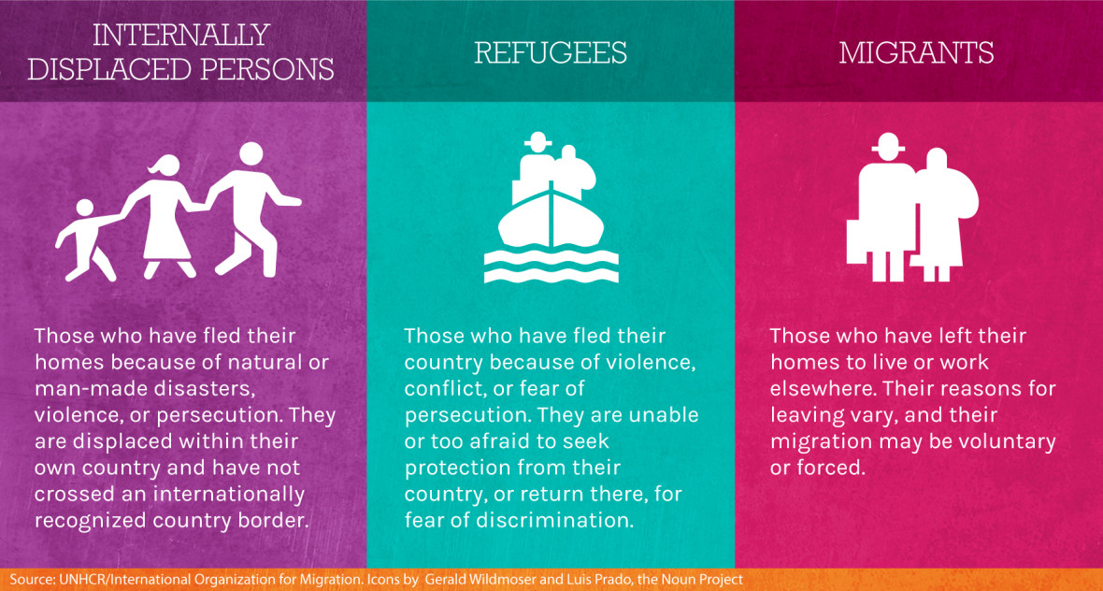
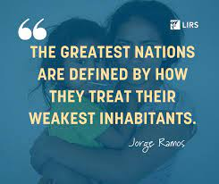
Immigrants and Refugees

Slide 22
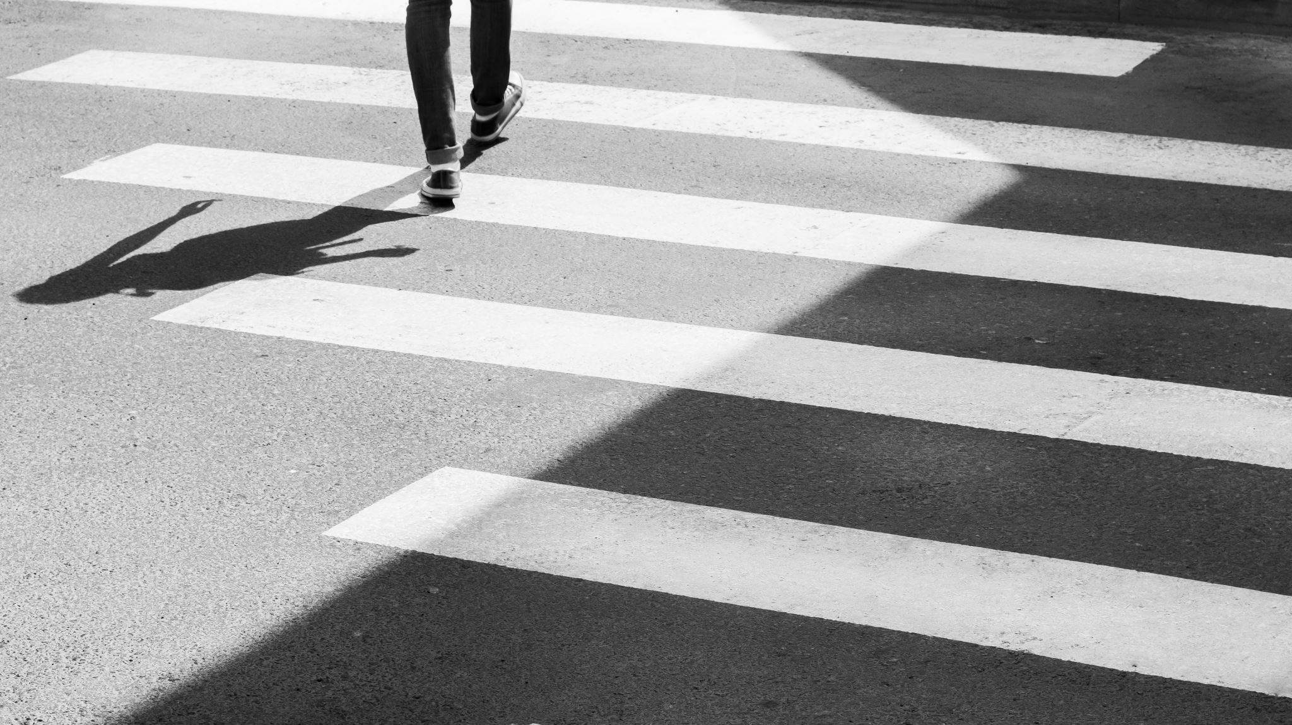
Hispanics in Minnesota

Slide 23
Hispanics/Latinos in Minnesota
In Minnesota, the Hispanic/Latino population is projected to nearly triple by 2035, from 196,300 in 2005 to an estimated 551,600
More than 275,000 Latinos live in Minnesota.
In 2014, 72 percent were of Mexican origin and 61 percent are U.S.-born.
Latinos are the state’s third fastest-growing racial group.
Latinos have been part of the cultural, social, and economic fabric of Minnesota since the 1800s.
Immigration increased in the 1920s with growing employment opportunities, especially in food processing, construction, and manufacturing.
The Twin Cities and southern Minnesota had the highest proportion of Hispanics in the state.

Slide 24
Religion Identities & Beliefs (Pew Research Center)
Family is the heart of the Hispanic culture.
Children taking care of their parents as their parents took care of them in their childhood is a ”circle of life”concept the Hispanic communities value.
Most Hispanics are Roman Catholics but it varies greatly by origin group and nativity.
55% Hispanic Catholics compared to 22% U.S. General Public
Protestantism is growing in the Hispanic populations:
22% Hispanics compared to 48% U.S. General Public
There are differences in affiliation between Hispanics who were born in the U.S. and those who were born outside the U.S.
Foreign-born Hispanics are more likely than U.S. born Hispanics to identify as Catholics
Foreign-born and native-born Hispanics are about equally to be Protestant
The native born are more likely to be religiously unaffiliated

Slide 25
Religion Identities & Beliefs
The Protestant tradition encompasses many denominational families, such as:
Baptists
Methodists
Lutherans
Pentecostals
Two thirds of Hispanics report that their current religion is the same as the one in which they were raised.
About 1/3 now belong to a religion that is different from their childhood faith.
Main reason for switching religions → dissatisfaction with religious institutions, practices or people; changes in personal spirituality; and family or life factors.

Slide 26
Discussion Questions
What is a myth about Spanish speaking people that you have / had?
How has the Hispanic story impacted the “American” story due to immigration, etc.?
What aspects of the Hispanic story resonate with you?
What about this topic is still stirring in you?
What additional knowledge / awareness do you seek so that you might better understand others?

Slide 27
Closing Prayer
Creator God,
We thank You for our wondrous diversity, for our cultures, traditions and languages, for all the ways we celebrate our humanity and praise Your divinity. We value all peoples, and in this time, we celebrate Hispanic Heritage Month. May we remember in our churches the leaders, teachers, and theologians that have been part of our Christian faith tradition. May we continue to hear from diverse voices that speak the truth of God's love, peace and justice for all peoples. Guide us in ways of new understandings to build a more inclusive church. In the name of Christ Jesus, our Savior, Redeemer and Friend, we pray. Amen.
-Rev. Mindi Welton-Mitchell
Dios Creador,
Te agradecemos por nuestra maravillosa diversidad, por nuestras culturas, tradiciones e idiomas, por todas las formas en que celebramos nuestra humanidad y alabamos Tu divinidad. Valoramos a todas las personas y en este momento celebramos el Mes de la Herencia Hispana. Que recordemos en nuestras iglesias a los líderes, maestros y teólogos que han sido parte de nuestra tradición de fe cristiana. Que podamos seguir escuchando voces diversas que hablan la verdad del amor, la paz y la justicia de Dios para todos los pueblos. Guíanos en formas de nuevos entendimientos para construir una iglesia más inclusiva. En el nombre de Cristo Jesús, nuestro Salvador, Redentor y Amigo, oramos. Amén.

Slide 28
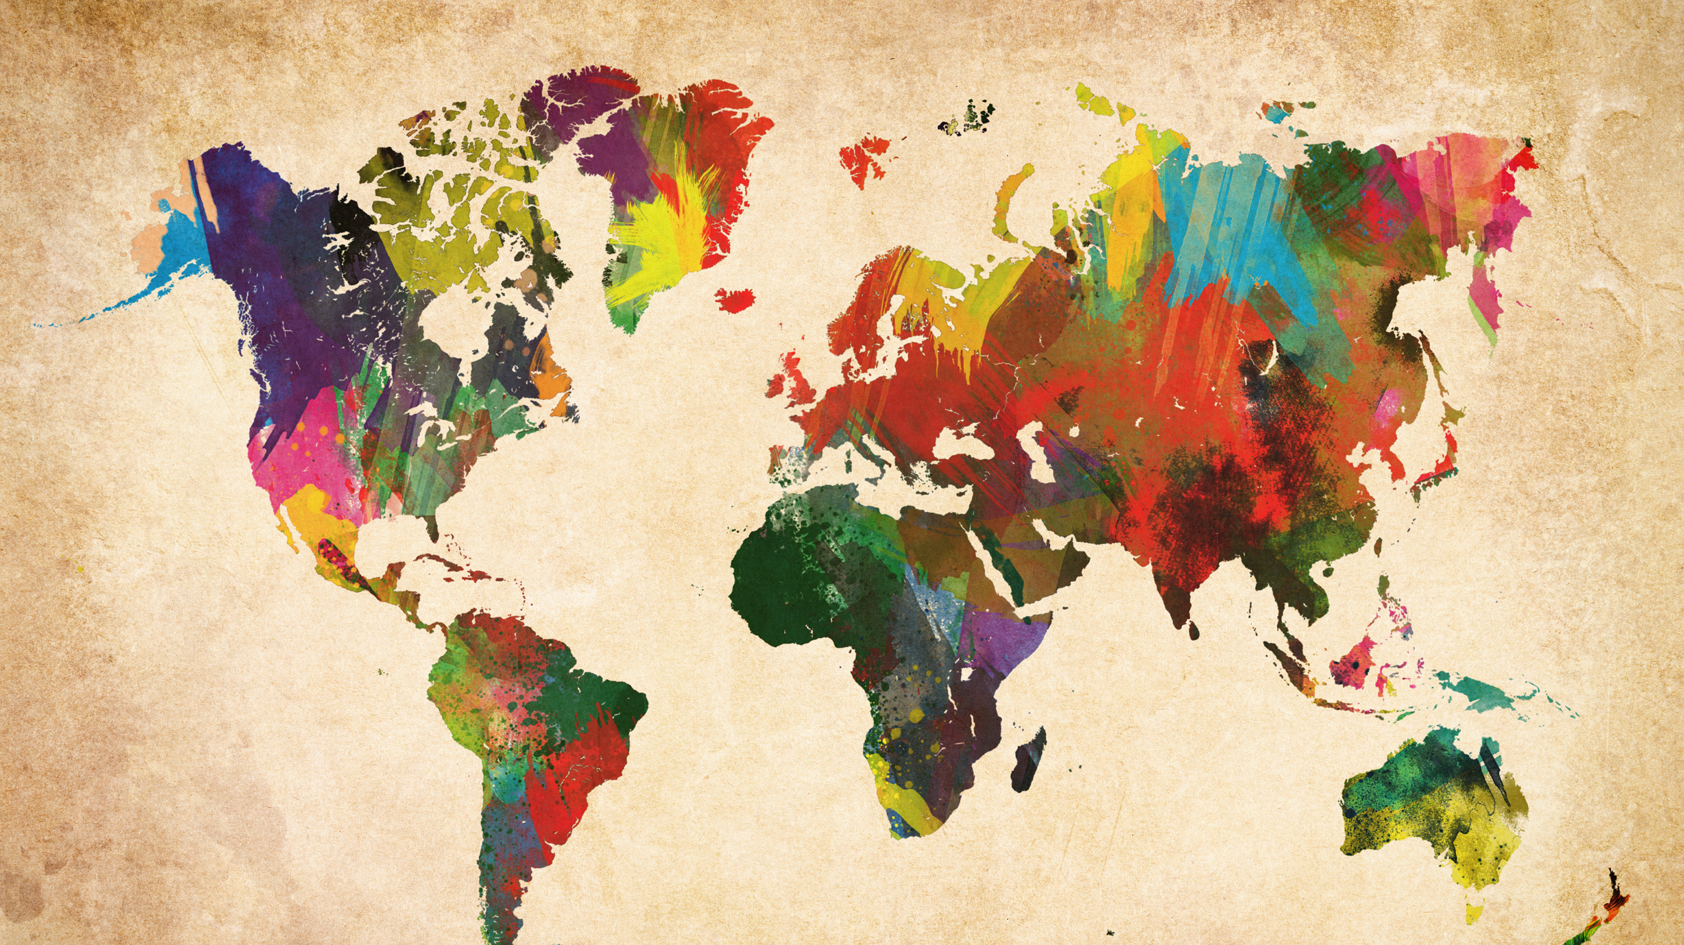
Upcoming Events
The God Who Sees Book Study- September 30th
Conversations on Race and Culture:
Jim Bear Jacobs- October 5th
Intersectionality-November 16th

